Slide 1

Module 2
Entrepreneurship and Strategy
Business Models and Strategy
Innovation
Value proposition and market analysis
The Business Plan
Elements of the Business Plan
The Marketing and Sales Forecasting

Slide 2
Strategy is the central, integrated, externally-oriented concept of how an organization will achieve its objectives (Hambrick & Fredrickson, 2001).
Entrepreneurial strategies are the plans that entrepreneurs develop to achieve their goals. Gundry, L.K. – 2020.
Strategic management is the body of knowledge that answers questions about the development and implementation of good strategies.

Slide 3
Entrepreneurial strategy is the set of decisions and actions that entrepreneurs take to shape and execute their business model, position their venture in the market, and compete effectively with rivals.
Entrepreneurial strategy aligns vision, mission, and goals with resources, ensuring cohesive direction and efficient resource allocation.
It enables entrepreneurs to create and capture value through innovation, differentiation, and customer-centric approaches, driving competitive advantage and profitability.
Entrepreneurial strategy allows proactive anticipation and effective response to changing customer needs, market dynamics, and competitive pressures, ensuring sustained relevance and growth.
It guides entrepreneurs in leveraging strengths and mitigating weaknesses, optimizing internal capabilities and positioning for market success.
It facilitates the identification and exploitation of opportunities while effectively managing and mitigating threats, enhancing resilience and strategic positioning in the market.
Entrepreneurial strategy promotes a culture of learning from successes and failures, fostering continuous improvement and adaptive strategies for long-term success.

Slide 4
The components of entrepreneurial strategy:
The opportunity - The opportunity is the problem or need that the entrepreneur wants to solve or satisfy with their product or service.
The resources - The resources are the assets and capabilities that the entrepreneur can use or acquire to exploit the opportunity.
The team - The team is the group of people who share the entrepreneur's vision and work together to execute the strategy.

Slide 5
Key Tactics For Mastering Entrepreneurial Strategy:
Identifying and validating a problem-solution fit and a product-market fit, ensuring the venture addresses real customer needs effectively.
Developing and testing a viable and scalable business model to sustainably deliver value, generate revenue, and manage costs.
Crafting and communicating a compelling value proposition that differentiates the venture and resonates with target customers.
Building and managing a strong team aligned with the venture's vision, mission, and values, crucial for execution and innovation.
Securing and allocating resources effectively across financial, human, physical, and intangible assets to support growth and operations.
Establishing and maintaining a competitive advantage through superior value, quality, service, or by leveraging niche markets or strategic alliances.
Experimenting and iterating based on feedback and data to refine strategies, business models, and value propositions, ensuring continuous improvement and adaptation.

Slide 6
Entrepreneurial Strategies:
Differentiation Entrepreneurial Strategy- This strategy encourages business owners to concentrate on creating goods or services that stand out from the competition due to their special qualities, high standards, or creative features.
Cost Leadership Entrepreneurial Strategy
Niche Market Targeting Entrepreneurial Strategy - The niche market targeting entrepreneurial strategy is a focused approach that aims to capture a specific segment of customers with unique needs or preferences.
Innovation and Disruption Entrepreneurial Strategy -
Strategic Partnerships and Alliances Entrepreneurial Strategy
Market Segmentation Entrepreneurial Strategy - a broader market into distinct segments based on specific characteristics, such as demographics,
Diversification Entrepreneurial Strategy - expanding a business’s product or service offerings into new markets or industries.
Product Development Entrepreneurial Strategy
Market Penetration Entrepreneurial Strategy
Franchising Entrepreneurial Strategy
Blue Ocean Entrepreneurial Strategy - The Blue Ocean Strategy is an entrepreneurial strategy that focuses on creating new market spaces where competition is minimal or non-existent.

Slide 7
Vertical Integration Entrepreneurial Strategy- The entrepreneurial strategy of vertical integration entails the extension of a company’s activities by the acquisition or control of numerous supply chain stages, from the procurement of raw materials through the distribution of the finished good or service.
Value Chain Analysis Entrepreneurial Strategy - The Value Chain Analysis entrepreneurial strategy involves identifying and analysing the various activities and processes that create value within a business.
Lean Start-up Entrepreneurial Strategy - The Lean Start-up business strategy stresses quick experimentation, iterative product development, and customer input to create a long-lasting and profitable company.
Exit Entrepreneurial Strategy

Slide 8
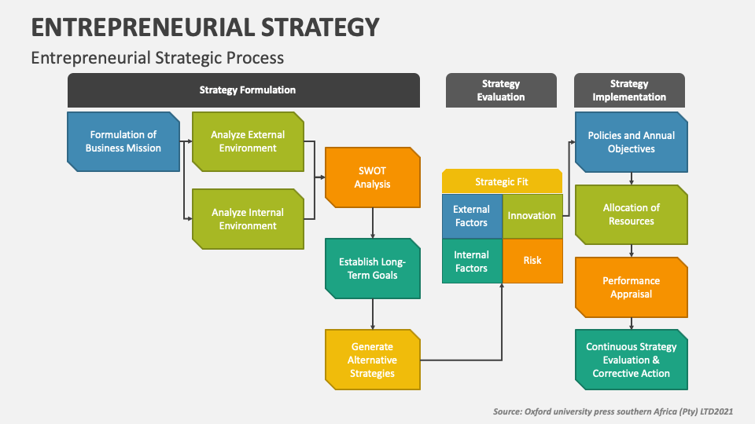

Slide 9
The Benefits Of Entrepreneurial Strategy
Innovation - Innovation is the creation or improvement of products or services that offer new or better value to customers.
Growth - Growth is the increase in the size, scope, or performance of the venture
Social impact - social impact is the positive effect that the venture has on the society, the environment, or the community.
Personal satisfaction - Personal satisfaction is the fulfilment or happiness that the entrepreneur derives from pursuing their passion and purpose.

Slide 10
The Challenges Of Entrepreneurial Strategy
Uncertainty - Uncertainty is the lack of information or knowledge about the future and the outcomes of the actions
Risk - Risk is the possibility of losing something of value or facing negative consequences
Competition - Competition is the presence of other players who offer similar or substitute products or services to the same customers.
Change... Change is the variation or alteration of the external and internal factors that affect the opportunity, the resources, and the team.

Slide 11
Business Models and Strategy
What is Business Strategy?
A business strategy is a complete contingent plan of action that a business uses to achieve its goals in the market.
What is a Business Model?
A business model is a structural model of how a business is going to operate in the market and how it is going to make money. It provides a detailed description of all relevant business processes and describes how the business will interact with other market participants.

Slide 12
A business model is a company's core strategy for profitably doing business.
Models generally include information like products or services the business plans to sell, target markets, and any anticipated expenses.
The two levers of a business model are pricing and costs.
A business model should be periodically revised to make sure it still reflects the business environment and customer demands.
Analysts and investors often look at a company's gross profit to evaluate the success of a business model.
KEY POINTS

Slide 13
Components of a Business Model:
Value Proposition: What value does the company deliver to customers?
Revenue Streams: How does the company make money?
Cost Structure: What are the major costs involved in delivering value?
Customer Segments: Who are the company’s customers?
Channels: How does the company reach its customers?
Customer Relationships: How does the company interact with its customers?
Key Resources: What resources are essential to the business?
Key Activities: What activities are crucial to delivering value?
Key Partnerships: What partnerships are important?

Slide 14
How to Create a Business Model
Identify Your Audience: Define your target market to tailor your product, messaging, and approach.
Define the Problem: Understand the problem your business aims to solve.
Understand Your Offerings: Align your products or services with market needs and your expertise.
Document Your Needs: Identify and document challenges and operational needs.
Find Key Partners: Establish relationships with partners that enhance your business offering.
Set Monetization Solutions: Determine how your business will make money and turn a profit.
Test Your Model: Perform tests, gather feedback, and make adjustments based on market responses.

Slide 15
Types of Business Models
Retailer:
Buys finished goods from manufacturers or distributors and sells directly to customers.
Manufacturer:
Sources raw materials to produce and sell finished products to distributors, retailers, or customers.
Fee-for-Service:
Charges for labor or specialized services, often on an hourly or fixed-fee basis..
Subscription:
Offers ongoing services or products for a recurring fee, fostering long-term customer relationships.
Freemium:
Provides basic services for free, with the option to upgrade to a paid premium version.
Example: LinkedIn.
Bundling:
Sells multiple products together, often at a discounted price, to increase customer value.
Marketplace:
Facilitates transactions between buyers and sellers, earning revenue by hosting the platform.
Example: eBay.

Slide 16
Affiliate:
Earns revenue by promoting products on behalf of other companies, often receiving a commission.
Example: Social media influencers.
Razor Blade:
Sells a durable product at a low cost while profiting from high-margin consumables.
Reverse Razor Blade:
Sells a high-margin product upfront, with low-cost or free companion products provided later.
Franchise:
Expands a business by allowing others to replicate its model in new locations, sharing profits.
Example: Domino's Pizza.
Pay-As-You-Go:
Charges based on usage rather than a fixed fee, common in utility services.
Brokerage:
Connects buyers and sellers, earning a commission from transactions without selling goods directly.

Slide 17
Innovation
Innovation is the lifeblood of entrepreneurship. It involves creating new ideas, products, services, or processes that add value and differentiate a business in the marketplace.
    Product Innovation: Developing new or improved products that meet customer needs and differentiate your business in the market.
    Process Innovation: Enhancing the efficiency and effectiveness of your business operations to deliver better value.
    Business Model Innovation: Rethinking how your business creates, delivers, and captures value to stay ahead of the competition.
    Market Innovation: Identifying and tapping into new markets or customer segments to expand your business reach.
    Organizational Innovation: Adapting your company’s structure, culture, or practices to foster innovation and improve performance.

Slide 18
Role of Innovation in Entrepreneurship
Creating Value: Innovating to develop unique value propositions that attract and retain customers in a competitive market.
Gaining Competitive Advantage: Differentiating your offerings through innovation to establish a sustainable edge over competitors.
Driving Growth: Leveraging innovation to expand market reach, improve efficiency, and create new revenue streams.
Adapting to Change: Using innovation to stay agile and relevant in a rapidly evolving business environment.
Fostering a Culture of Innovation: Encouraging creativity and risk-taking within your organization to sustain long-term success.

Slide 19
TIPS FOR BECOMING AN INNOVATIVE ENTREPRENEUR
Develop a financial plan
Accept constructive feedback
Develop patience
Promote your brand
Cultivate a Growth Mindset
Build a Strong Network

Slide 20
Challenges Faced by Innovative Entrepreneurs
      Market Acceptance: Overcoming initial scepticism and resistance to convince consumers and businesses to adopt novel products or services.
      Securing Funding: Raising capital for high-risk innovations by demonstrating potential returns to cautious investors.
      Intellectual Property Protection: Navigating complex and costly intellectual property laws to safeguard innovations from imitation or theft.
      Talent Acquisition: Building a team with the right skills and a willingness to venture into uncharted territory to drive innovation.
      Regulatory Compliance: Addressing uncertain legal environments and complying with regulations that may not yet account for innovative products and services.

Slide 21
Future Trends in Innovative Entrepreneurship
    Sustainability and Social Impact: Entrepreneurs will drive innovations that address environmental and social challenges, focusing on clean energy, sustainable agriculture, and social enterprises.
    Digital Transformation: Continued digitalisation across industries will spur innovation in AI, blockchain, and IoT, enabling new solutions that enhance efficiency, security, and connectivity.
    Remote Work and Collaboration Technologies: As remote work grows, demand for innovative tools that enhance virtual collaboration and productivity will lead to advancements in virtual workspaces and immersive meetings.
    Healthcare Innovation: Entrepreneurs will lead in developing telehealth, personalised medicine, and wearable health technologies as healthcare faces challenges from ageing populations and rising costs.
    Decentralisation and Democratisation of Technology: The rise of blockchain and peer-to-peer technologies will empower entrepreneurs to create more transparent, equitable, and decentralised solutions across various sectors.

Slide 22
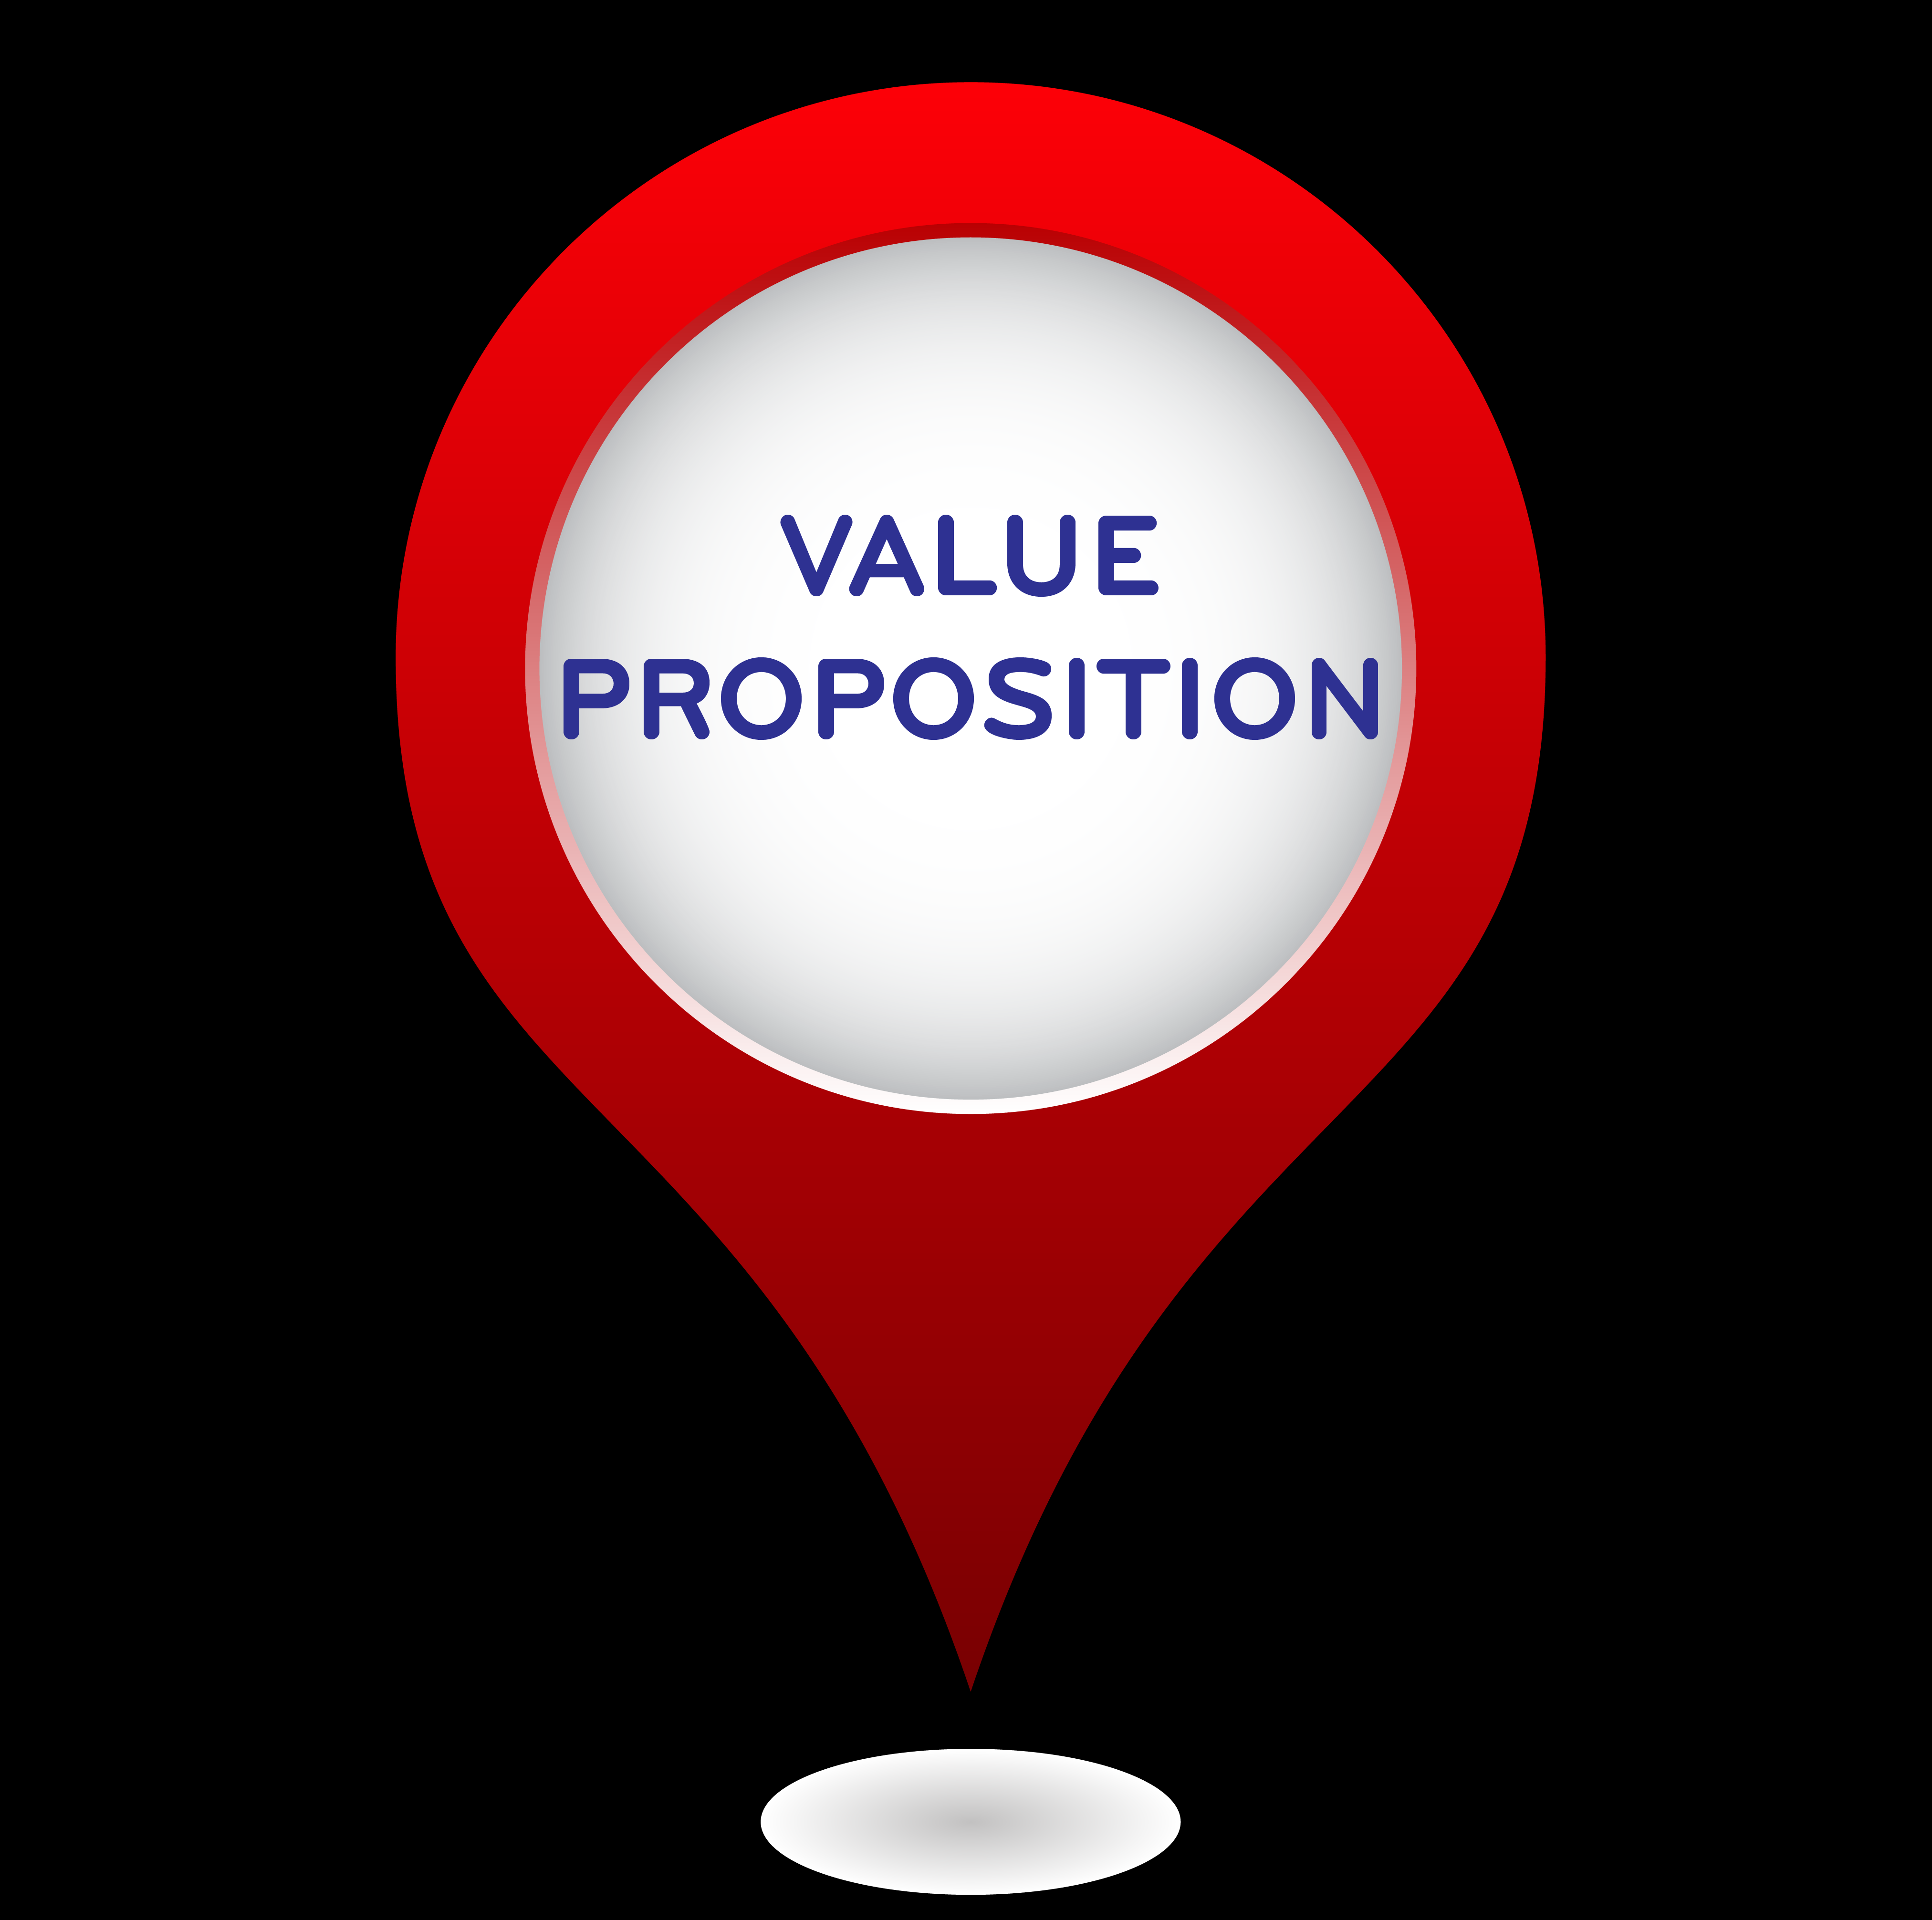
VALUE PROPOSITION AND MARKET ANALYSIS
    A value proposition defines the benefits your company's products and services offer to the customer.
    A strong value proposition offers tangible benefits like cost savings and enhanced performance, along with intangible benefits such as convenience, trust, and emotional connection.
    It communicates the clearest benefit that customers receive by giving you their business.
    A great value proposition may highlight what makes you different from competitors, but it should always focus on how customers define your value.

Slide 23
Tangible Benefits
Cost Savings - A software tool that automates processes might reduce labour costs by 20%.
Time Savings - A mobile banking app that allows customers to complete transactions immediately
Improved Quality
Increased Productivity
Enhanced Performance
Physical Features
Revenue Growth
· Intangible Benefits
Brand Reputation - Customers feel confident buying from a well-known, trusted brand.
Customer Satisfaction
Convenience
Peace of Mind
Status and Prestige - Owning a luxury item that conveys social status and exclusivity.
Innovation
Emotional Connection
Loyalty and Trust
Personalization

Slide 24
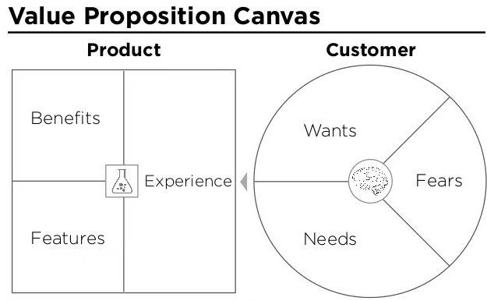
HOW TO WRITE A VALUE PROPOSITION: 3 OPTIONS

Slide 25
These three questions:
Which customers are you going to serve?
Which needs are you going to meet?
What relative price will provide acceptable value for
customers and acceptable profitability for the customer?
Try the Steve Blank formula apply (Steve Blank, a former Google employee who runs the Lean Start-up Circle)
We help (X) do (Y) by doing (Z).

Slide 26
HOW TO CRAFT A STRONG VALUE PROPOSITION:
Identify Customer Needs: Understand the specific problems or pain points your target customers face. This involves deep research into their behaviours, preferences, and challenges.
Define the Product/Service Offering: Clearly describe what you are offering and how it addresses the identified needs. Focus on the key benefits rather than just features.
Highlight Differentiation: What sets your product or service apart from the competition? This could be based on innovation, quality, pricing, customer experience, or other factors.
Communicate Value: Explain the tangible and intangible benefits customers will gain from using your product or service. This could include cost savings, improved efficiency, enhanced convenience, or superior performance.
Concise and Clear Statement: The value proposition should be a brief, compelling statement that quickly communicates the unique value of your offering.

Slide 27
MARKET ANALYSIS
Conducting a market analysis can benefit you in several ways:
Spot Trends and Opportunities in Your Industry: Identify emerging trends and market opportunities to stay ahead of the competition.
Differentiate Your Business from Competitors: Understand the competitive landscape and find ways to make your business stand out.
Tailor Products and Services to Your Target Customers' Needs: Customize your offerings to better meet the specific needs and preferences of your target market.
Reduce the Risks and Costs of Launching a New Business (or Pivoting an Existing One): Make informed decisions that minimize risks and avoid costly mistakes when entering new markets or pivoting.
Reach New Market Segments: Identify and expand into new customer segments, increasing your market reach.
Optimize Your Marketing Efforts: Focus your marketing strategies on the most promising areas, improving efficiency and effectiveness.
Analyse Successes and Failures: Learn from past performance to improve future outcomes and avoid repeating mistakes.
Monitor Your Business's Performance: Continuously track and evaluate your business’s progress to ensure it aligns with your goals.
Pivot Your Business in New Directions: Use insights from the analysis to adapt and explore new directions for growth and innovation.
“A market analysis is an in-depth evaluation of a market to determine suitability for a business or product.”

Slide 28
VALUE PROPOSITION IS CLOSELY CONNECTED WITH MARKET ANALYSIS
· Identifying Customer Needs
· Understanding Competitors
· Defining Target Market
· Market Opportunities and Gaps
· Aligning with Market Trends

Slide 29
BUSINESS PLAN
A business plan is a detailed document that outlines a company's objectives, strategies, and financial forecasts.
The different types of business plans, each tailored for specific purposes:
Start-up Business Plan: A comprehensive plan outlining the goals, strategies, and financial projections for a new business, designed to attract investors and secure funding.
Internal Business Plan: A plan focused on the internal operations of a business, used by management to guide decision-making and track progress toward company goals.
Strategic Business Plan: A high-level plan that defines the long-term goals of a business, along with the strategies and actions needed to achieve them, often spanning several years.
Feasibility Business Plan: A plan that assesses the viability of a new idea or venture, examining market potential, costs, and potential profitability before full-scale development.
Operations Business Plan: A detailed plan that outlines the day-to-day operations of a business, including production, logistics, supply chain management, and staffing.
Growth Business Plan: A plan focused on strategies for expanding a business, whether through new markets, additional products, or increased operations, typically used to attract investment or guide internal growth efforts.

Slide 30
ELEMENTS OF THE BUSINESS PLAN
A business plan is a document that outlines the long-term strategy for a venture. It formally details how the business intends to generate revenue, who will make key decisions, and how operations will be conducted.
1. Executive Summary
    Overview: A brief summary of the entire business plan, including the business name, location, and the product or service offered.
    Mission Statement: A concise statement about the purpose of the business and its core values.
    Business Objectives: Short-term and long-term goals for the business, such as revenue targets or market expansion.
    Keys to Success: Critical factors that will contribute to the success of the business, such as unique strengths or strategic advantages.
2. Company Description
    Business Overview: Details about what the business does, its legal structure (e.g., sole proprietorship, partnership, corporation), and the business model.
    Company History: Background information about the business's founding, milestones, and evolution.
    Mission and Vision: Statements outlining the company's purpose and future aspirations.
    Business Structure: Information about the organizational structure and key roles.
3. Market Analysis

Slide 31
4.Value Proposition
    Customer Needs: Description of the specific needs or problems that the product or service addresses.
    Product/Service Offering: Explanation of the product or service and how it meets the identified needs.
    Differentiation: What makes the offering unique compared to competitors' products or services.
    Tangible Benefits: Measurable advantages such as cost savings, time savings, and improved quality.
    Intangible Benefits: Emotional or psychological benefits like brand trust, convenience, and customer satisfaction.
5. Organization and Management
6. Products or Services
7. Marketing and Sales Strategy
    Marketing Plan: Strategies for promoting the product or service, including advertising, public relations, and digital marketing.
    Sales Strategy: Sales process, techniques, and structure, including the sales force and distribution channels.
    Pricing Strategy: Pricing model and rationale, including comparisons to competitors.
    Advertising and Promotion: Plans for reaching and engaging with the target audience.
8. Operations Plan
    Operational Processes: Description of the daily operations and workflow within the business.
    Location and Facilities: Information about the physical location of the business and any facilities used.
    Technology: Technologies and systems used in business operations.
    Supply Chain Management: Details on suppliers, inventory management, and logistics.

Slide 32
9. Financial Plan
    Revenue Model: How the business will generate revenue, including pricing and sales forecasts.
    Funding Requirements: Amount of funding needed, how it will be used, and sources of capital.
    Financial Statements: Projected income statement, cash flow statement, and balance sheet.
    Break-even Analysis: Calculation of the point at which the business will start to be profitable.
10. Risk Analysis
    Risk Factors: Identification of potential risks and challenges that could impact the business.
    Mitigation Strategies: Plans and strategies to address and reduce identified risks.
11. Supporting Documents
    Additional documents that support the business plan, such as resumes, legal agreements, market research data, and detailed financial projections.

Slide 33
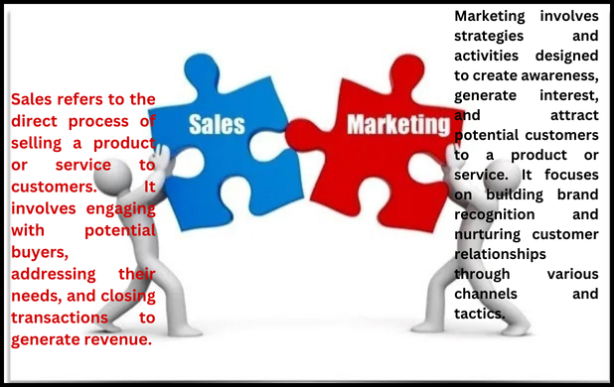
THE MARKETING AND SALES FORECASTING

Slide 34
Sales Forecasting
Historical Data Analysis: Review past sales data to identify trends, seasonality, and patterns that can inform future predictions.
Market Trends: Analyse current market conditions and trends that could impact future sales, such as changes in consumer behaviour or economic factors.
Sales Goals: Set specific, measurable sales targets based on historical performance, market potential, and business objectives.
Sales Channels: Evaluate the performance of different sales channels (e.g., online, retail, direct sales) and project their contributions to future sales.
Product or Service Lifecycle: Consider the stage of your product or service lifecycle (introduction, growth, maturity, decline) and how it affects sales.
Sales forecasting is the process of estimating a company’s sales revenue for a specific time period – commonly a month, quarter, or year. A sales forecast is prediction of how much a company will sell in the future.

Slide 35
Marketing Forecasting
Market Research: Conduct research to understand market demand, customer preferences, and competitive dynamics.
Marketing Strategy: Develop and forecast the impact of various marketing strategies and campaigns, such as promotions, advertising, and content marketing.
Budget Allocation: Plan and allocate the marketing budget across different channels and activities based on expected returns.
Customer Acquisition: Forecast the number of new customers expected to be acquired through marketing efforts and estimate their potential lifetime value.
Brand Performance: Assess how brand awareness and reputation will influence marketing outcomes and customer engagement
A marketing forecast is an analysis that projects the future trends, characteristics and numbers (potential sales figures based on current data and market research) in your target market. It provides anticipated numbers that a company expects based upon market research.

Slide 36
Integration of Sales and Marketing Forecasts
  Alignment: Ensure that sales forecasts are aligned with marketing efforts to create a cohesive strategy that supports business goals.
  Feedback Loop: Use insights from sales performance to adjust marketing strategies and vice versa, creating a dynamic approach to forecasting.
  Scenario Planning: Prepare for different scenarios (e.g., best-case, worst-case) to understand potential variations in sales and marketing outcomes and adjust plans accordingly.

Slide 37
Some Questions We Need To Ask …………………
What are the most effective methods or tools for improving forecast accuracy?
How do companies handle forecast deviations or inaccuracies?
How can businesses use scenario analysis in forecasting?
How do companies forecast for new product launches with limited historical data?
What role does machine learning play in modern sales forecasting?
How do different industries approach sales forecasting?
How do you balance qualitative and quantitative data in forecasting?
What impact do global economic trends have on sales forecasting?
How do external factors like regulatory changes and geopolitical events affect forecasts?
How can businesses reduce the impact of bias in sales forecasting?

